Slide 1
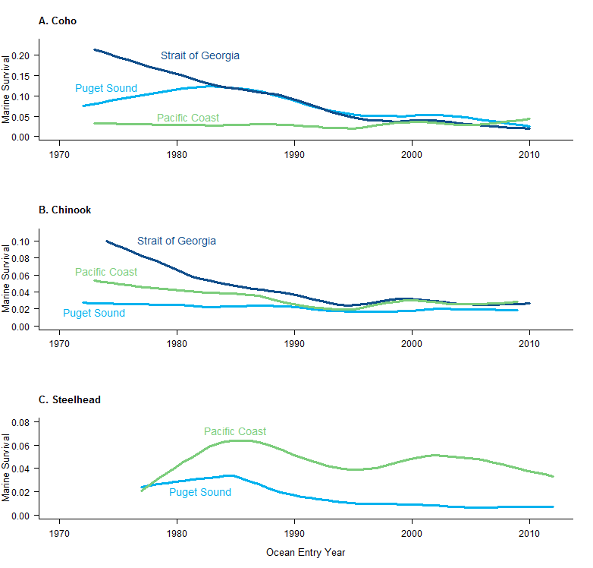
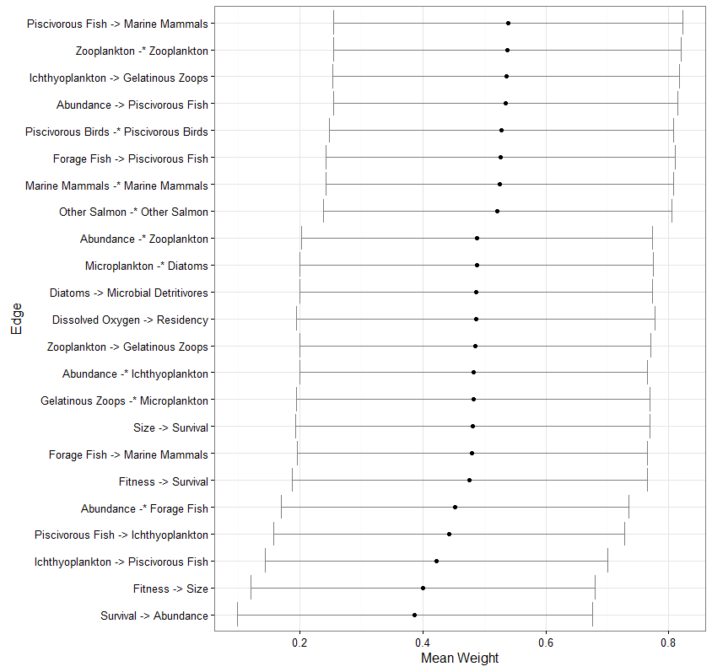
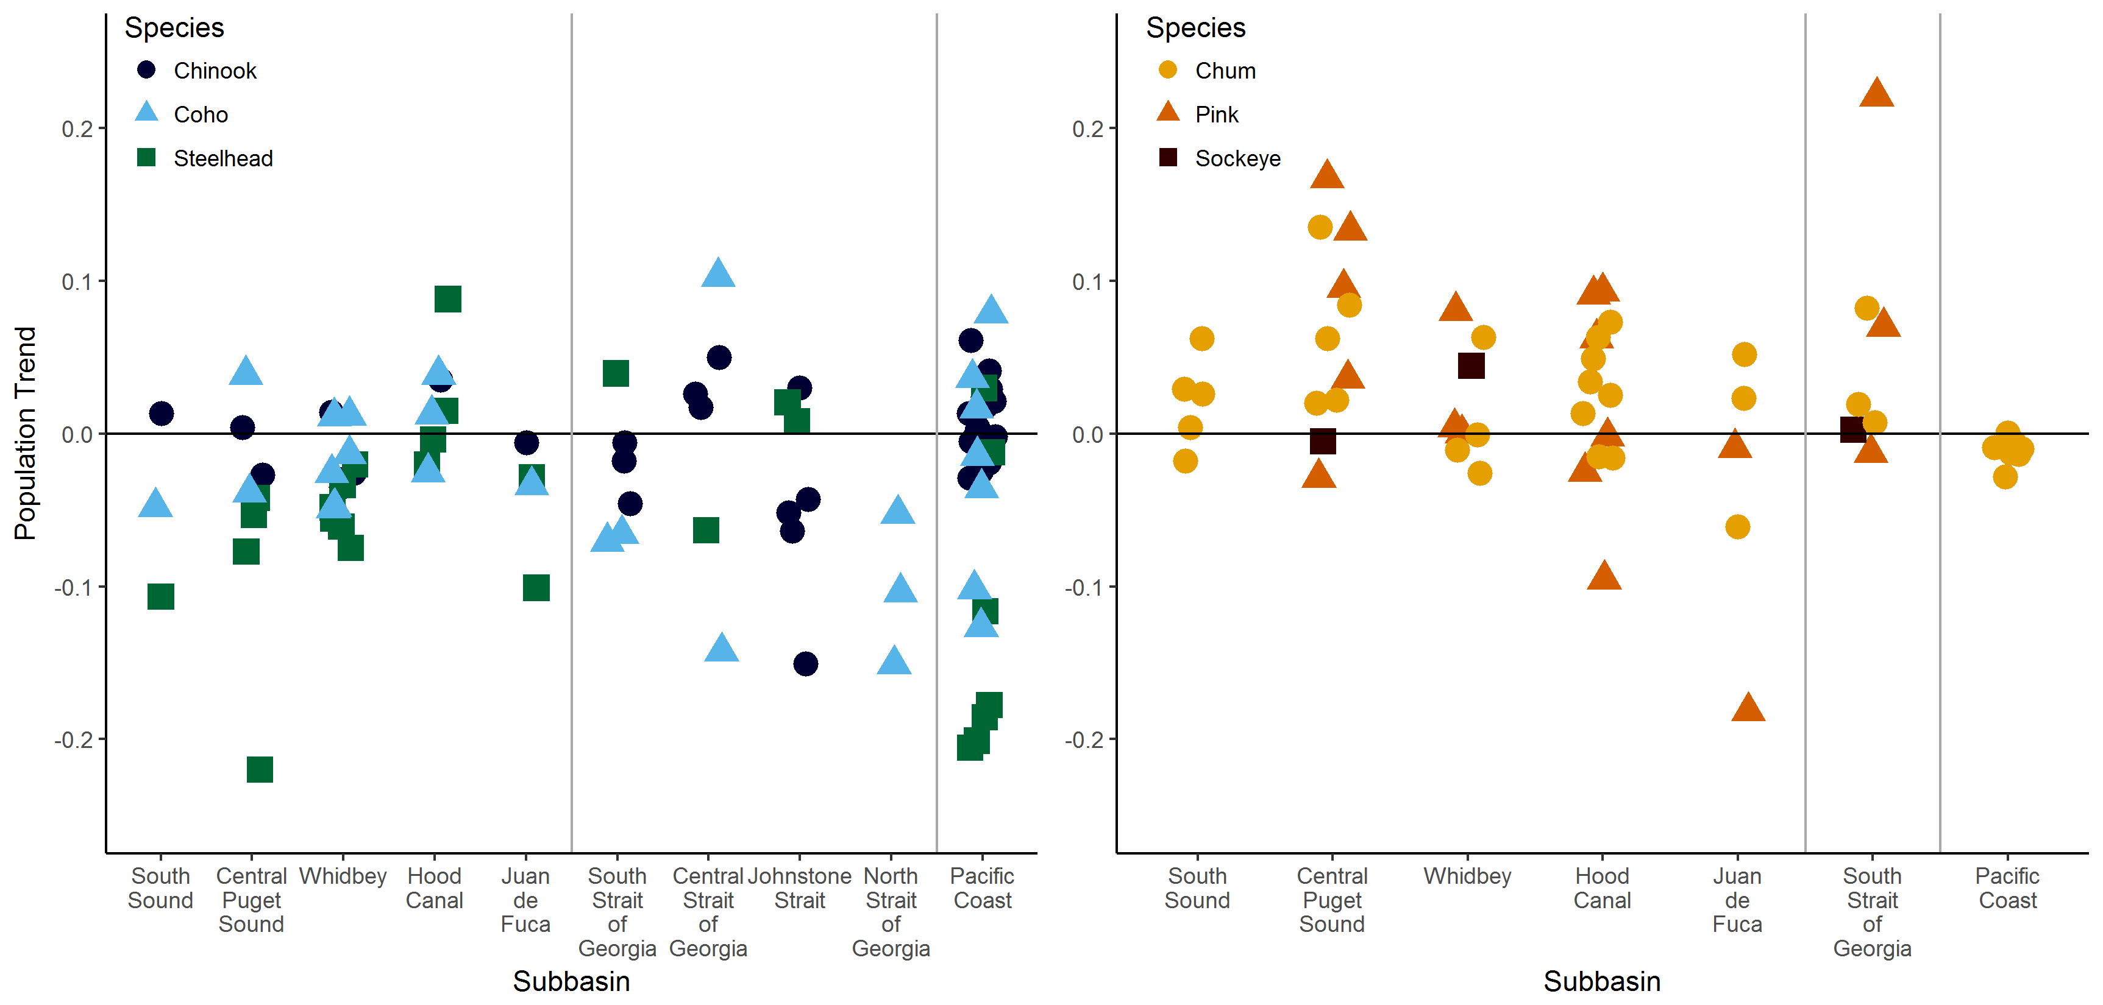
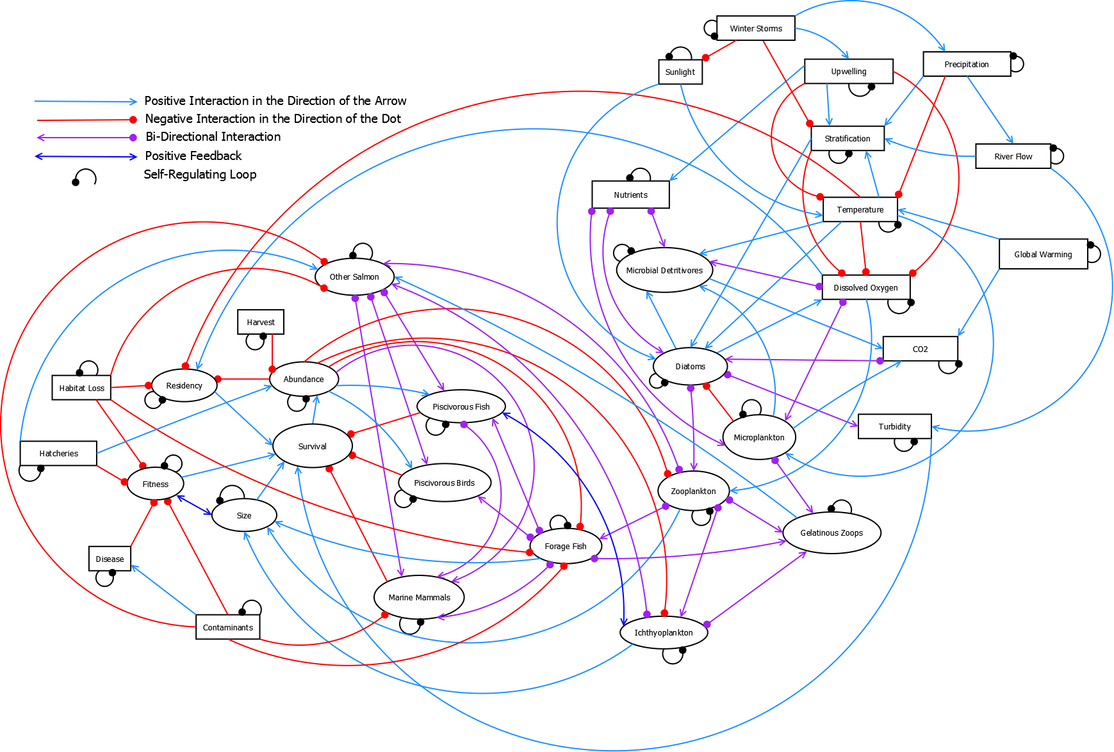


Exploring Drivers in Declining Marine Survival in Pacific Salmon K.L. Sobocinski^{1,2}, C. Greene¹, M. Schmidt² 1. NOAA-Fisheries NWFSC 2. Long Live the Kings
Background
Once the conceptual model was developed, we used an existing modeling package (QPress) in the R programming language to assess the relative impacts of the suite of drivers on the nodes related to salmon. While salmon survival was of primary interest, related attributes such as abundance, size, fitness, and residence time were also included as response variables. Additionally, we represented other salmon species (Chum, Sockeye, and Pink Salmon, grouped as Other Salmon) that have not seen the same decline in survival.
We aimed to answer:
Which drivers had the strongest impact (positive and negative) on survival
and other nodes of interest?
How do the cumulative impacts of multiple factors manifest in
basin-to-basin comparisons?
Which edges were the most sensitive to change?
To assess the sensitivity of the model links in the simulation weighting routine, we calculated means and standard deviations of the weights in the accepted models (10,000 out of ~122,000 runs). While most links were not sensitive to the weights applied (U(0,1)), a subset were above or below the grand mean.
Coho (Oncorhnychus kisutch), Chinook (O. tshawytscha), and Steelhead (O. mykiss) have shown declines in marine survival in Puget Sound and the Strait of Georgia over the last 40 years.
Where the mean is >0.5, balanced models had higher weights on this linkage.
Where the mean is <0.5, more accepted models had lower weights.
These linkages could be considered more sensitive within the model.
While we would expect the linkages among salmon attributes to be sensitive, the edges connecting foodweb components are important and sensitive indicators.
The Salish Sea Marine Survival Project aims to tease out drivers of this decline (http://marinesurvivalproject.com/). Using a qualitative network model, we evaluated hypothesized drivers of marine mortality, ran simple scenarios of cumulative effects for example Salish Sea basins which show differences in abundance trends, and describe the results here.
Results
We invoked a perturbation to each node (direction of the perturbation based on known trends) and evaluated the response of the other nodes in 10,000 model simulations.
To evaluate the cumulative impacts to salmon as observed within Puget Sound, we generated 3 scenarios based upon observed changes in various regions. We then invoked all perturbations and plotted the response of all nodes.
Strong Neg. Effect (>80% of runs negative)
Weak Neg. Effect (60-80% of runs negative)
Neutral (40-60% of runs positive/negative)
Weak Pos. Effect (60-80% of runs positive)
Strong Pos. Effect (>80% of runs positive)
Methods
Drivers | Variables | Invoked Perturbation | Response Variables
 |  |  | Survival | Abundance | Fitness | Size | Residency | Other Salmon
Environmental | Sunlight | ↑
 | Winter Storms | ↑
 | Precipitation | ↑
 | Upwelling | ↓
 | Stratification | ↑
 | Temperature | ↑
 | River Flow | ↑
 | Turbidity | ↓
 | Dissolved Oxygen | ↓
Production | Nutrients | ↑
 | Microplankton | ↑
 | Microbial Detritivores | ↑
 | Diatoms | ↓
Foodweb | Zooplankton | ↓
 | Gelatinous Zooplankton | ↑
 | Forage Fish | ↓
 | Ichthyoplankton | ↓
 | Other Salmon | ↑
 | Piscivorous Fish | ↓
 | Piscivorous Birds | ↓
 | Marine Mammals | ↑
Anthropogenic | Hatcheries | ↑
 | Harvest | ↑
 | Habitat Loss | ↑
 | CO2 | ↑
 | Global Warming | ↑
 | Contaminants | ↑
 | Disease | ↑
Drivers | Perturbations | South Sound | Hood Canal | Central Basin
Oceanographic | Nutrients | ↑
 | Stratification |  | ↑
 | Dissolved Oxygen |  | ↓
 | Turbidity |  | ↓
 | Temperature |  | ↑
Foodweb | Diatoms |  |  | ↓
 | Gelatinous Zooplankton | ↑ |  | ↑
 | Forage Fish | ↓ |  | ↓
 | Other Salmon |  | ↑
Anthropogenic Impacts | Contaminants | ↑ |  | ↑
 | Habitat Loss |  |  | ↑
 | Hatcheries | ↑
 | Survival
 | Abundance
 | Fitness
 | Size
 | Residency
 | Other Salmon
To begin, we built a conceptual diagram (a digraph), consisting of 33 hypothesized drivers (nodes) and the directed links (edges) among them. Relationships between any two nodes could be positive or negative. The nodes included environmental, foodweb, and anthropogenic factors.
Modeled salmon survival was strongly negative in South Sound and Central Basin, but less so in Hood Canal, which reflects observations to date.
Conclusions
Qualitative Network Modeling indicates that anthropogenic impacts and changing foodwebs should be further evaluated in the decline in marine survival of Coho, Chinook, and Steelhead. There are likely cumulative pathways to declining survival, mediated through a number of feedbacks expressed within our model.
Anthropogenic impacts had strong negative impacts on survival, abundance, and fitness. Other factors producing negative responses to survival were: ↓ diatoms and ↑ in other salmon. Decreased zooplankton negatively impacted focal salmon fitness and size. These impacts are largely foodweb effects, either through direct predation or competition. Increasing CO₂, winter storms, and precipitation had largely positive impacts on salmon attributes; while increasing temperature and declining dissolved oxygen resulted in negative salmon response.
References
Qualitative Network Modeling is a data-free, flexible modeling approach. We included attributes of the focal salmon species (survival, abundance, fitness, etc.) and environmental, foodweb, and anthropogenic drivers in the model. This type of analysis has been used to model shellfish response to stressors (Reum et al. 2015), Antarctic ecosystems (Melbourne-Thomas et al. 2012), and fisheries management actions (Harvey et al. in press).
Harvey, C.J., J.C.P. Reum, M.R. Poe, G.D. Williams, S.J. Kim. In Press. Using conceptual models and qualitative network models to advance integrative assessments of marine ecosystems. Coastal Management.
Melbourne-Thomas, J., S. Wotherspoon, B. Raymond, and A. Constable. 2012. Comprehensive evaluation of model uncertainty in qualitative network analyses. Ecological Monographs, 82(4): 505–519.
Reum, J.C.P., B.E. Ferriss, P.S McDonald, D.M. Farrell, C.J. Harvey, T. Klinger, and P.S. Levin. 2015. Evaluating community impacts of ocean acidification using qualitative network models. Marine Ecology Progress Series 536: 11-24.

